Slide 1

Capstone Project - The Battle of Neighborhoods
Selecting the best location for a new bookstore in New York City

Slide 2
Introduction
A bookstore is a place where different kinds of textbooks or reference books are sold
There are many bookstores in the city of New York. Serious considerations are required to open a new bookstore than it seems
The aim of this project is to assist investor who wants to open a new bookstore in new york

Slide 3
Business problem
A client hired us to help him determine what is the best place for a new bookstore in new york city. We deﬁne potential neighborhood based on the number of bookstores which are operating right in each neighborhood. Brooklyn has full potential but also is a very challenging district to open a business because of high competition. New bookstore should be open in an area that inadequate neighborhood in this way the Restaurant can attract more customers/readers.
Therefore, this analysis necessary to ensure that we have enough customers and that we are not so close to other bookstores.

Slide 4
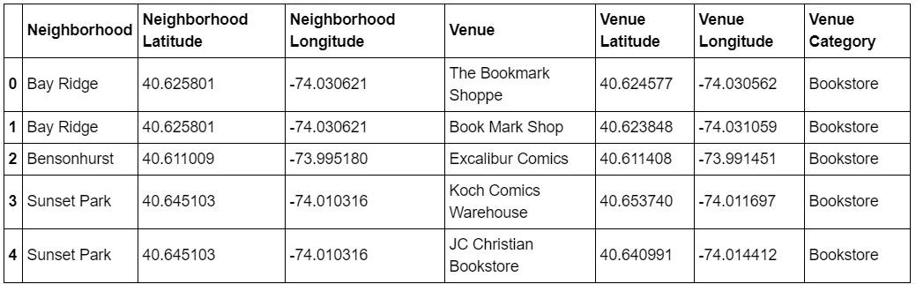
Data Selection
To identify the characteristics of our competitors' venues in Brooklyn, we would ﬁrst need to ﬁnd out the number of bookstores in Brooklyn currently and their location.
We then ﬁnd their geographic coordinates of new york city to create a folium map Using Foursquare API to explore the bookstores operating in Brooklyn area

Slide 5
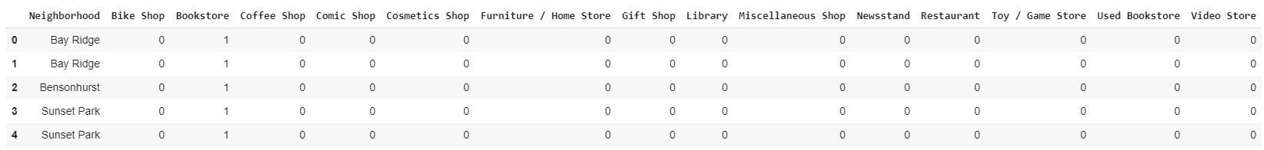
Methodology
Addresses are stored and visualized using their equivalent latitude and longitude values.
Foursquare API is used to explore neighborhoods in Brooklyn, New York. After that, explore
function to get bookstores categories in each neighborhood.

Slide 6
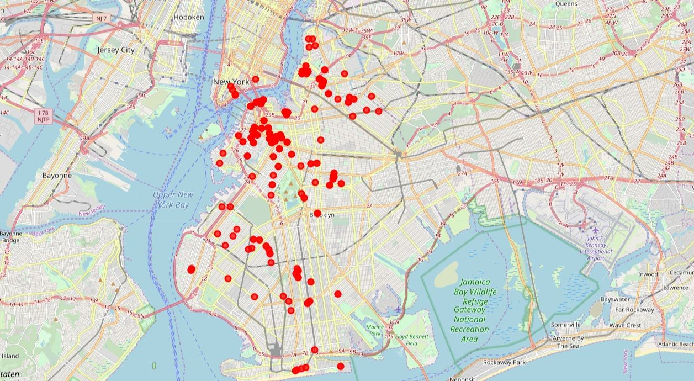
Bookstores in New York

Slide 7
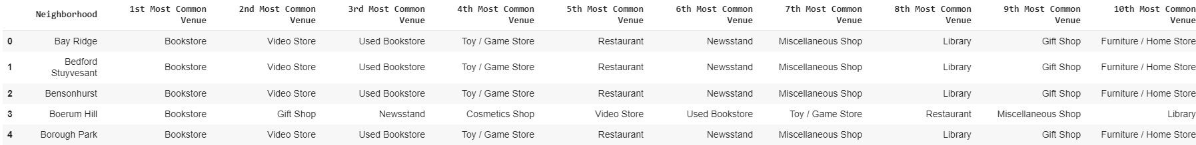
Then using this feature to group the neighborhoods into clusters K-means clustering algorithm will be use to complete this task. And also, the Folium library to visualize the neighborhoods in Brooklyn and its emerging clusters.

Slide 8
Results
Using K-mean to clustering data area with less number of bookstores

Slide 9
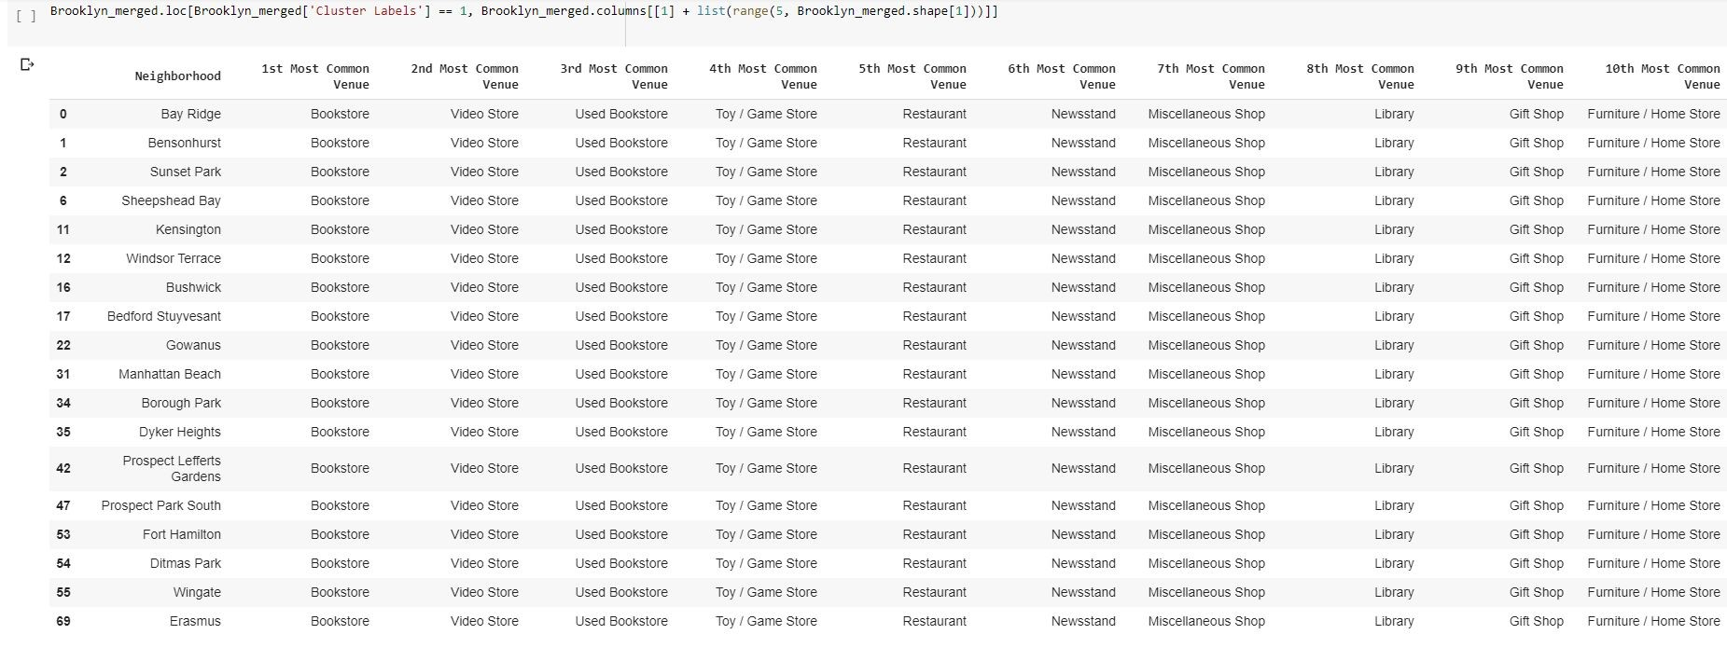
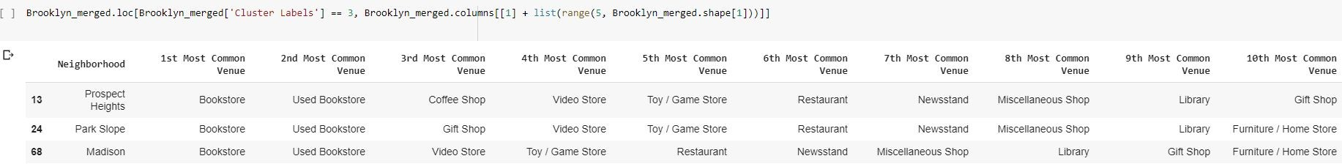

Slide 10
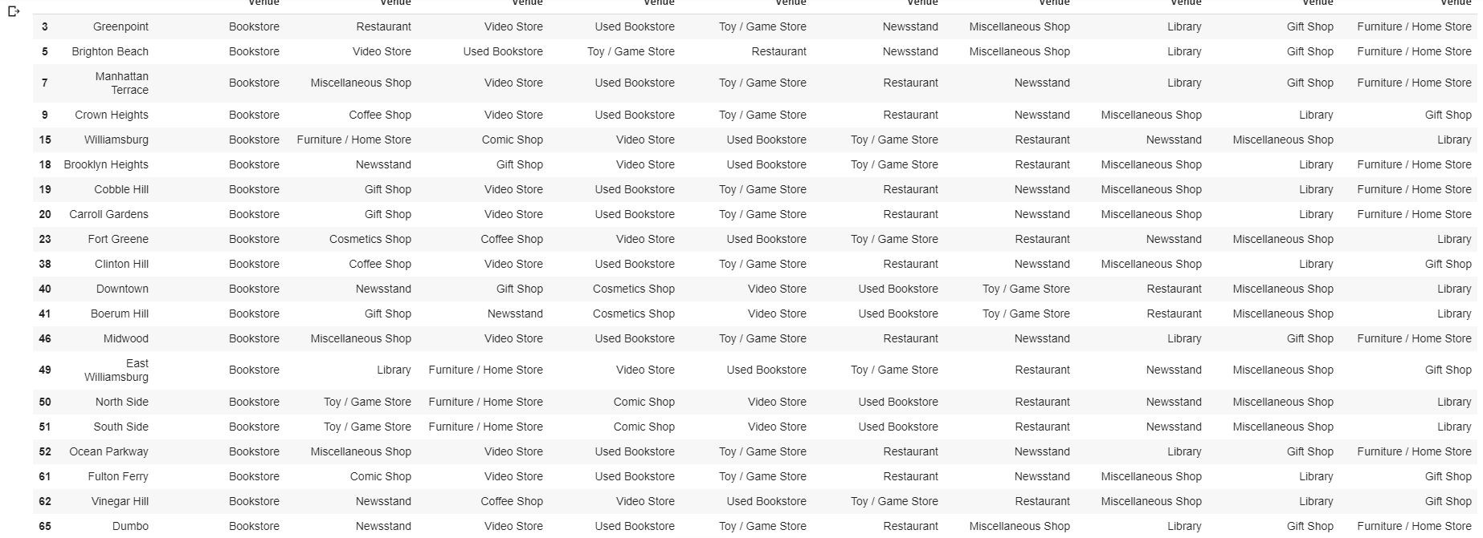

Slide 11
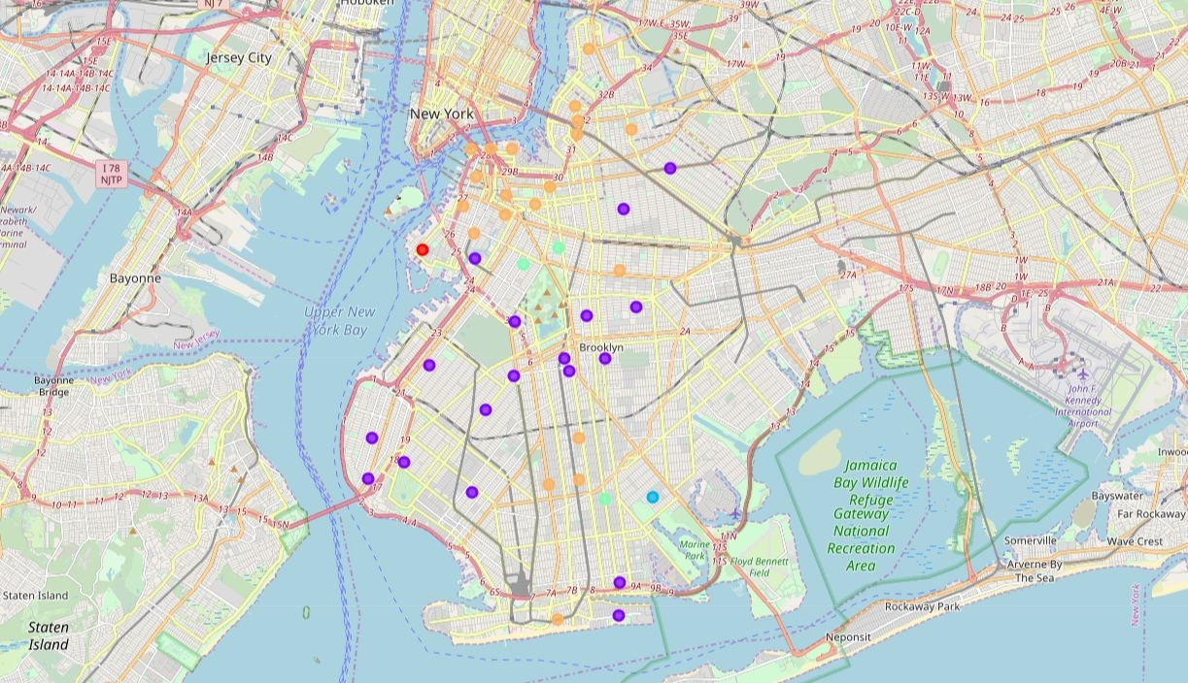
Results
Based on analysis done, Cluster 1 (Red Hook) and Cluster 3 Marine Park areas are the best places to open a new bookstore business.

Slide 12
Discussion
This analysis is performed on limited data
Marine Park is one of the good locations to open an bookstores that focus on new textbook than used books.
Prospect Heights, Park Slope and Madison are also good places to be considered to open the new bookstore.
Further and more detailed study on full dataset of New York is needed to have more accurate and in depth analysis will be required to have a ﬁnal decision that might include budget and location mortgage prices.

